Slide 1

reImagine Technologies
David Moreno
Mario Raushel
Terence Sin
Caleb Wells

Slide 2

Contents
Background
Requirements
Design
System
Demonstration
Team Management and Teamwork
Concerns
Final Product

Slide 3
Background
Needs
There is a need for users to autonomously create and explore daily photo life logs for both a fun and interesting experience.
Problem
Create log of your daily movement
Visualize day through captured images
Goal
The goal for this project is to create a wearable camera system capable of recording GPS data that will automatically record the daily life of the user based on a variety of triggers, and organize data.

Slide 4
Requirements
The prototype design should cost no more than $500
The prototype must be battery powered and capable of logging a 12 hour session
The camera unit should not cause any harm to the user or others
The camera should function well both indoors and outdoors

Slide 5
Requirements
The GPS should function well in outdoor urban areas and have a decent failover for loss of signal indoors
The design must be comfortable to wear and lightweight (< 1 lb)
Accompanying software must be easy to use and understand
The camera unit must take good quality pictures (at least 320 x 240 resolution)

Slide 6
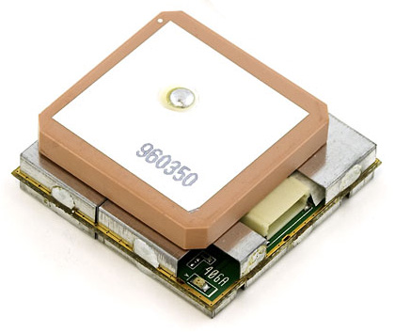
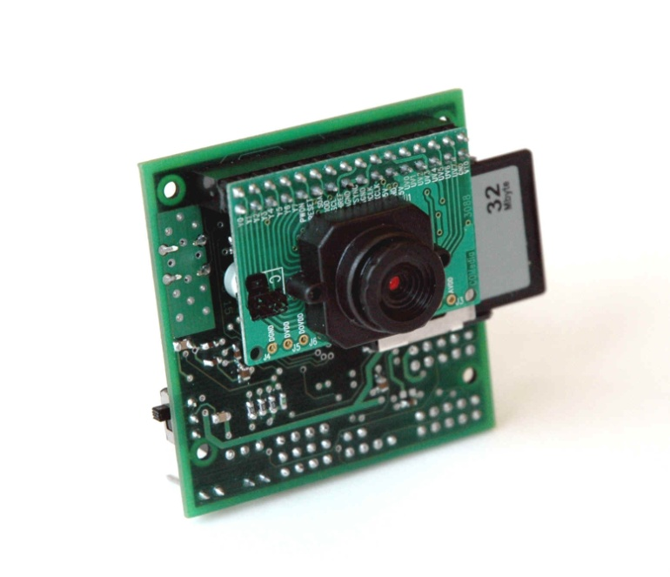
Components
GPS
EM-406A SiRF III Receiver
Camera
CMUCam3

Slide 7
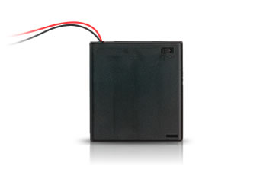
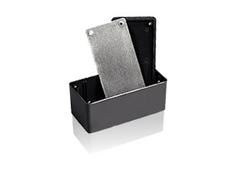
Components
Power
4AA Batteries
Enclosure
5x2.5x2 Project Box

Slide 8
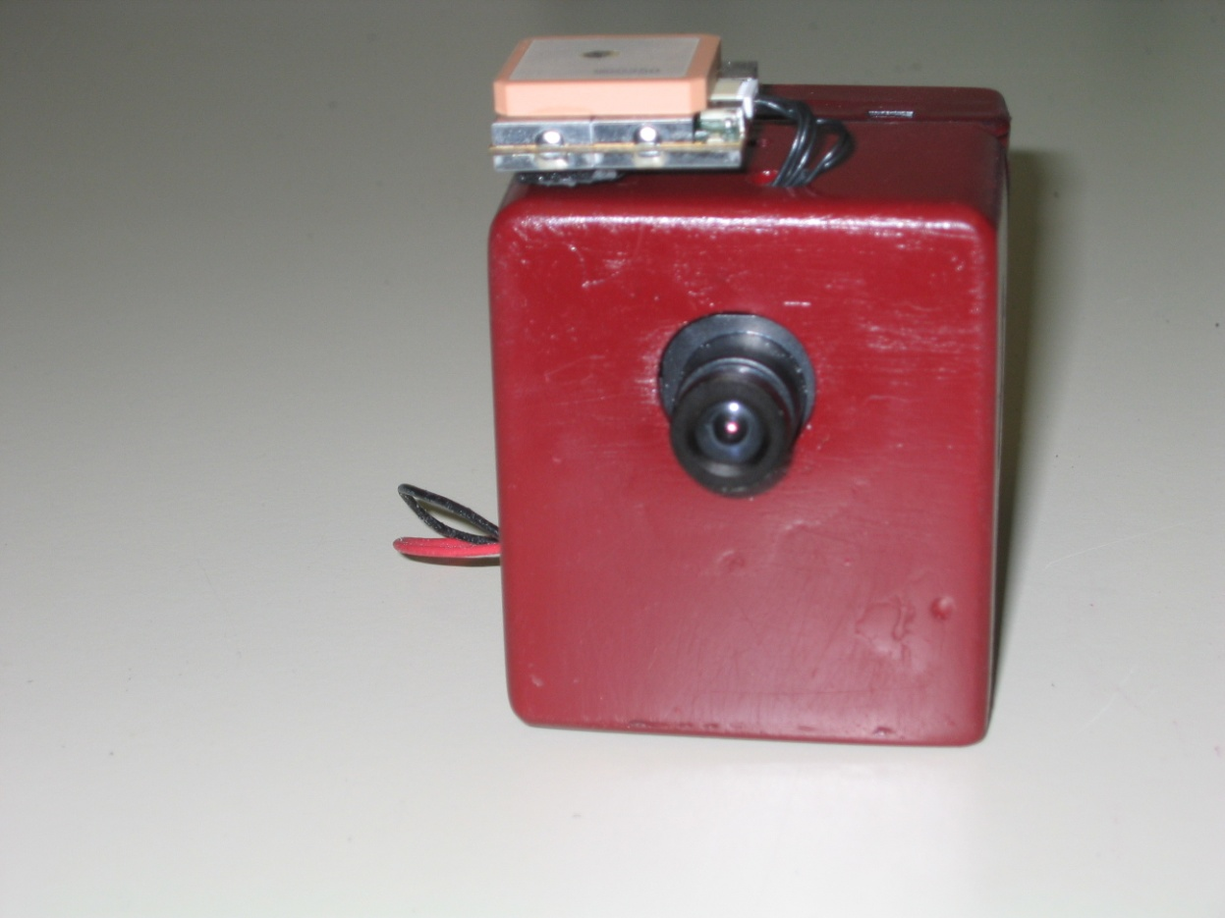
Enclosure Design
Final dimensions: 2.75”x2.5”x1.5”

Slide 9
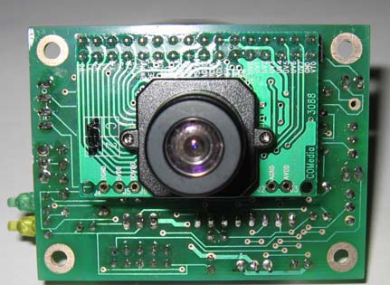
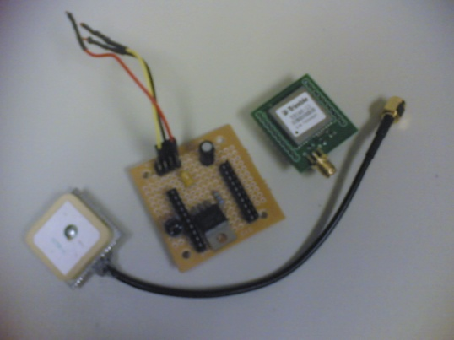

Design Alternatives
Camera
AVRCam
CMUCam2
GPS
Trimble Copernicus
SiRF II
Enclosure Designs
Custom Acrylic
Aluminum Project Box
Web Services
Flickr

Slide 10
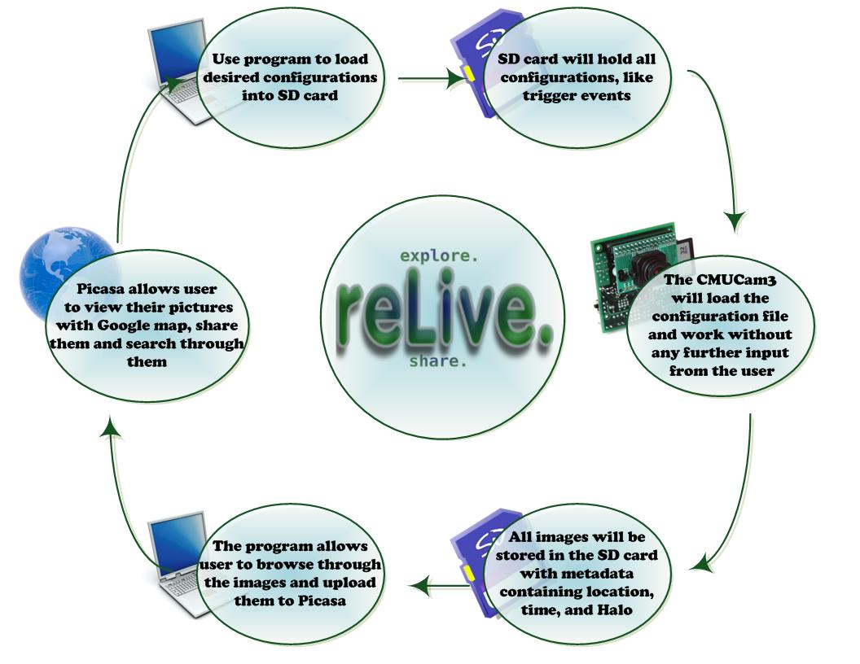

Slide 11
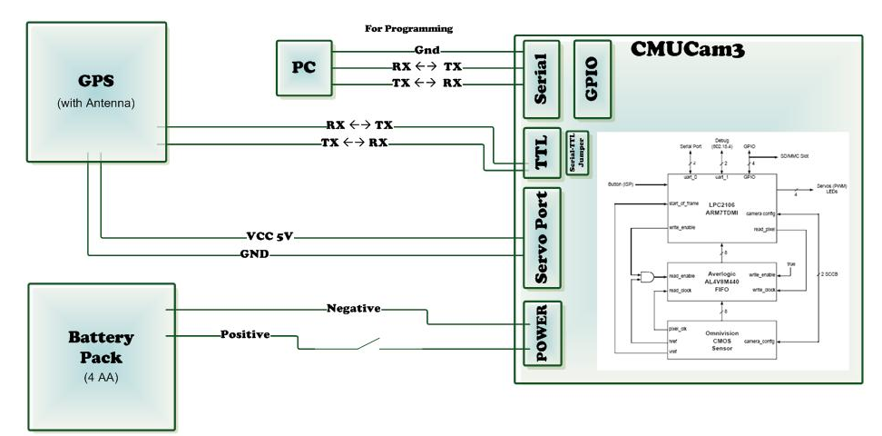
Hardware Design

Slide 12
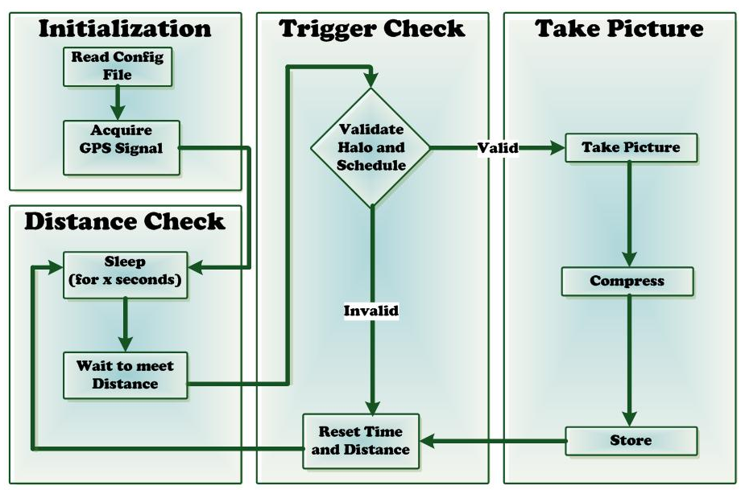
CMUCam3 Program Design

Slide 13
Trigger Settings
Time Delay (Minutes) - The amount of time the camera must wait between each picture taken
Minimum Distance - The distance a user must travel before another picture is taken.
Scheduler – Times during which pictures should be taken.
Location Halo - The center and radius of a halo where pictures must be taken.

Slide 14
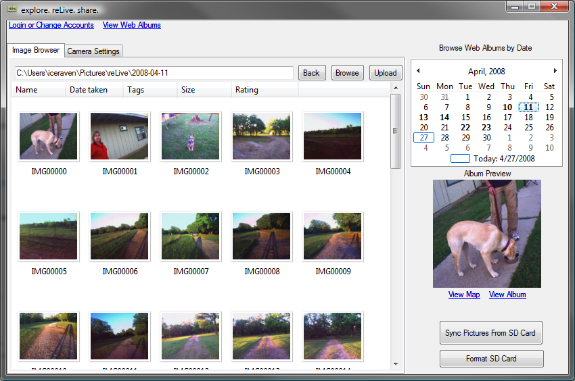
Software Demo

Slide 15
Team Management
David Moreno
Hardware and CMUCam3 operations
Purchasing
Mario Raushel
Software design and implementation
Terence Sin
Software and hardware interaction design
Caleb Wells
Leader
Hardware and GPS operations
Enclosure Design

Slide 16
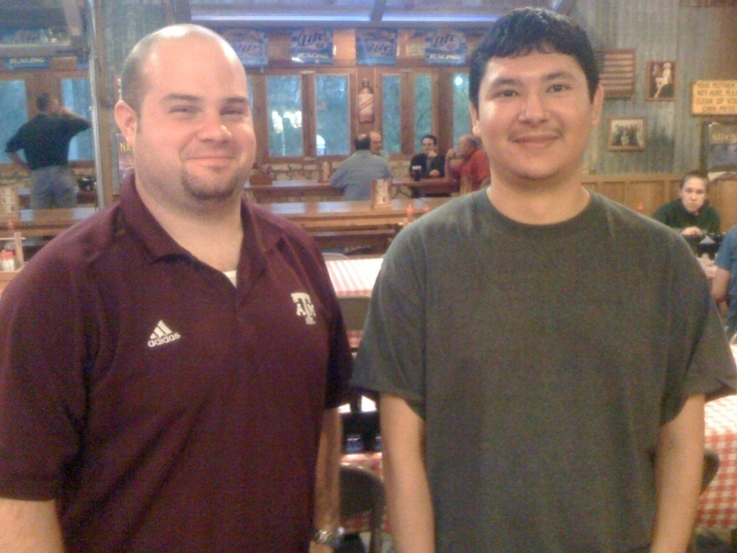
Effective Teamwork
2-3 meetings each week to discuss updates and plans
Bi-weekly email communication providing individual progress reports
Team building activities such as meeting at Rudy’s for dinner
Overcame problems as a team

Slide 17
Societal, Safety, Political, and Environmental Analysis
Societal Analysis
For privacy concerns the camera must be large enough that others can tell they are being photographed
Safety Analysis
Used non-conductive enclosure
Used NiMH batteries instead of Li-ION
Political Analysis
Each time the software is run, the user must agree not to use the device for malicious or illegal reasons.
Environmental Analysis
Will be supplied with rechargeable , recyclable batteries
Lead free device

Slide 18
Manufacturability, Sustainability and Economics
Manufacturability
Hardware easily mass produced
Software easily distributed
Programmed on CMUcam3
Sustainability
AA Batteries can be recharged or replaced
Information synchronized to both computer and Google
Economics
Low bulk material cost
CMUcam3 is licensed to distributers

Slide 19
Final Product
Budget
CMUcam3 $239.00
EM-406A SiRF III GPS Unit $88.24
Enclosure $3.69
Battery Pack $1.99
4x AA Rechargeable Batteries $10.00
Epoxy $3.00
Various Connectors $6.00
1Gb SD Card $15.00
Total for Unit $366.92

Slide 20
Evaluation Results
Test Runs
Tested Halo, Distance, Schedule in different runs.
Battery Life
The battery lasted 15 hrs when configured to take a picture every 1 min and 30 sec.
Usability
Had unfamiliar users test program

Slide 21
Evaluation Results
Accuracy Test
MAX | 51.327
MIN | 43.08
MEDIAN | 45.9835
MEAN | 46.07655
Max - Min | 8.247
Max - Mean | 5.25045
Mean - Min | 2.99655

Slide 22
Overview
Background
Requirements
Design
System
Demonstration
Team Management and Teamwork
Concerns
Final Product

Slide 23
Any Questions?

